Slide 1

Hospital Management System
A robust and comprehensive system for managing hospital operations.
Streamline patient care, improve administrative efficiency, and enhance financial performance.

Slide 2
Introduction and Key Features
Streamlining Operations
Key Features
The Hospital Management System (HMS) is designed to streamline hospital operations by automating tasks, reducing manual errors, and improving communication.
Doctor Directory
Department Overview
Appointment Booking
Enhanced Patient Care
Patient Accounts
The HMS empowers patients by providing them with greater control over their healthcare journey, allowing them to access essential information and manage their appointments with ease.
Payment Integration

Slide 3

Purpose of HMS
Streamlining Operations
Enhancing Patient Care
Reducing Administrative Burden
Automating hospital workflows to improve daily operations and reduce manual tasks.
Enabling doctors to remotely monitor patients through updated medical records, ensuring better follow-up and care.
Minimizing paperwork and errors by optimizing appointment scheduling and medical record management
Saving Patient Time
Enabling Real-Time Monitoring
Reducing wait times and simplifying administrative processes, allowing patients to receive care more efficiently.
Providing doctors with real-time access to patient data for continuous monitoring and quicker response times.

Slide 4
Component of HMS
Patient Management: Manages patient details and medical history.
Provides quick access to records, improving care
Staff Management: Tracks staff schedules and shifts.
Enhances coordination and reduces conflicts
Appointment Scheduling: Facilitates booking and managing appointments.
Simplifies the process for patients and staff
Medical Records Management: Stores diagnosis, treatments, and test results.
Allows real-time access to medical data.
Billing & Invoicing: Manages payments and invoicing.
Streamlines payment processes and ensures accuracy.

Slide 5

Tools and Technologies Overview
1
Development Environment
2
Back-End Development
Visual Studio 2022 provided a robust environment for coding, debugging, and managing the project.
C# enabled the development of a secure and scalable server-side application for handling data and processing requests.
3
Front-End Development
4
Database Management
HTML and CSS were used to create a user-friendly and visually appealing interface, ensuring a smooth and intuitive user experience.
SQL Server provided a powerful and reliable platform for managing data, ensuring data integrity and high performance.
5
Interactivity
6
Tool Integration
We incorporated JavaScript to add interactive elements to the front-end, improving user experience and enabling dynamic page updates without needing full page reloads.
The combination of these technologies—C#, HTML, CSS, JavaScript, and SQL Server—worked seamlessly together, helping us complete the project with quality and efficiency.

Slide 6
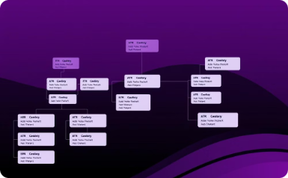
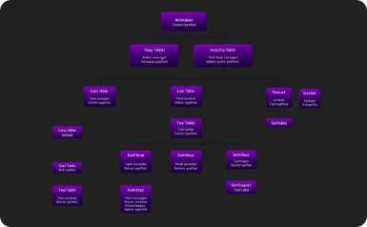

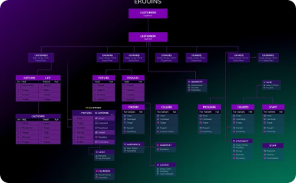
Description of ERD
Department Table
Doctor Table
Patient Table
Medical Record Table
Provides details on hospital departments, including their location, logo, and description.
Stores information about doctors, such as their name, address, contact information, hire date, salary, and shift type.
Holds patient information, including name, contact details, and age.
Stores critical patient medical information, such as diagnosis, treatment plans, medication, test results, and discharge summaries.

Slide 7
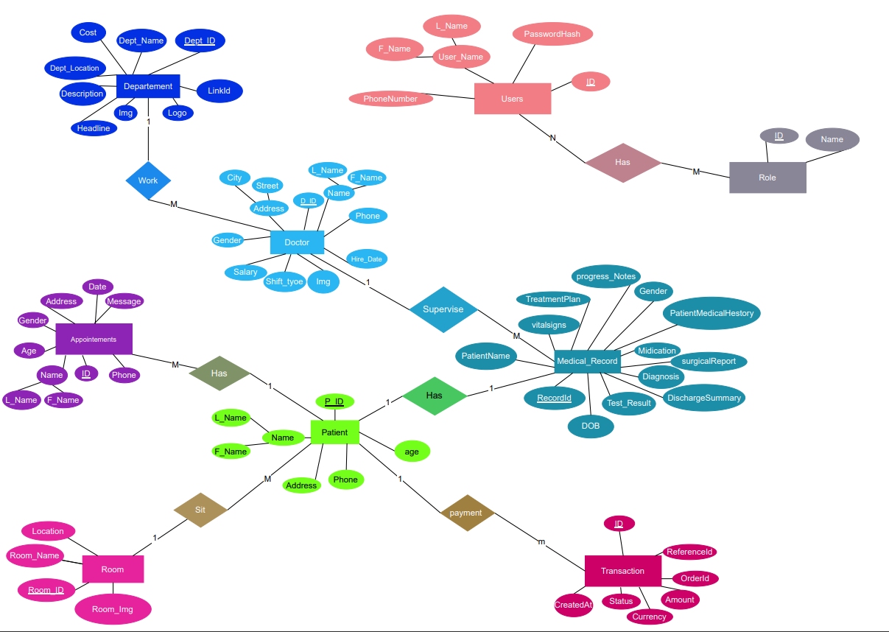
System Design: ERD
An ERD, or Entity-Relationship Diagram, is a visual representation of the data structure of the HMS. The ERD depicts entities, which represent data objects, and relationships between them. It helps in designing a well-organized and efficient database structure by illustrating how different parts of the HMS interact.
Each entity in the diagram is represented by a rectangle, and relationships between entities are depicted by lines connecting them. The lines indicate the type of relationship between entities, such as one-to-one, one-to-many, or many-to-many. The ERD is a valuable tool for understanding the data flow and relationships within the HMS, ensuring data integrity and efficiency.

Slide 8
Description of Schema
1
Department
2
Doctor
Contains details about hospital departments, such as name, location, and description. It is linked to the Doctor table through a foreign key.
Stores information about doctors, including their name, address, salary, and department affiliation. It is linked to the Department table through a foreign key.
3
Patient
4
Medical Record
Contains patient information, such as name, contact details, age, and their assigned room. It is linked to the Room table through a foreign key.
Manages critical patient medical information, such as diagnosis, treatment plans, medication, test results, and discharge summaries. It is linked to the Doctor and Patient tables through foreign keys.
5
Appointment
6
Room
Manages patient appointments, including appointment date, doctor details, and contact information. It is linked to the Patient table through a foreign key.
Holds information about hospital rooms, including location, room name, and image.
7
Transaction
8
Users & Roles
Handles payment and financial transactions, storing order details, status, amount, and currency. It is linked to the Patient table through a foreign key.
Manages login and user roles within the system, linking to the specific privileges of each user.

Slide 9








System Design: Schema
Department
Doctor
Patient
Dept\_ID (PK), Name, Location, Description
D\_ID (PK), Name, Address, Salary, Dept\_ID (FK)
P\_ID (PK), Name, Address, Phone, Room\_ID (FK)
Medical Record
Appointment
Room
RecordId (PK), Diagnosis, Medications, D\_ID (FK), P\_ID (FK)
ID (PK), Date, Time, Doctor, P\_ID (FK)
Room\_ID (PK), Name, Location, Image
Transaction
Users & Roles
ID (PK), Amount, Status, P\_ID (FK)
UserID (PK) for Users, RoleID (PK) for Roles

Slide 10
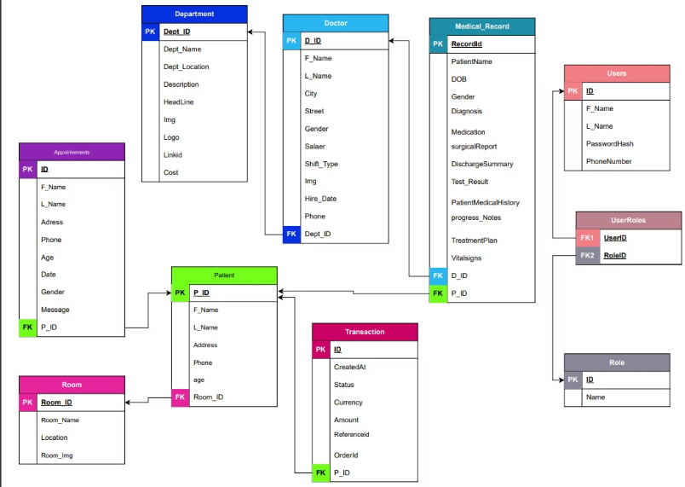
System Design: Schema
The schema defines the structure of data stored in the HMS database. Tables are defined for patient information, appointments, medical records, and staff details. Relationships between tables ensure data integrity and efficient data retrieval.
Each table represents a specific entity within the hospital system. For example, the "Patient" table stores patient demographics, contact information, and medical history. The "Appointment" table stores details about scheduled appointments, including patient ID, appointment date, and service type.

Slide 11
Website Preview
In the upcoming slides, I will present a preview of the Hospital Management System's website, highlighting its key features and user interface design.
Stay tuned to see how our system enhances user experience and streamlines hospital operationس

Slide 12



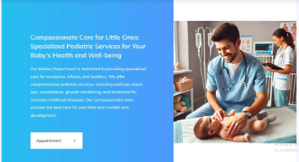

Department

Slide 13

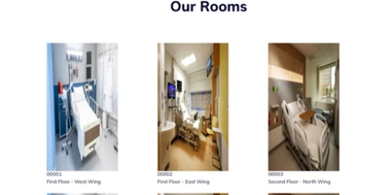

Doctor and Room

Slide 14
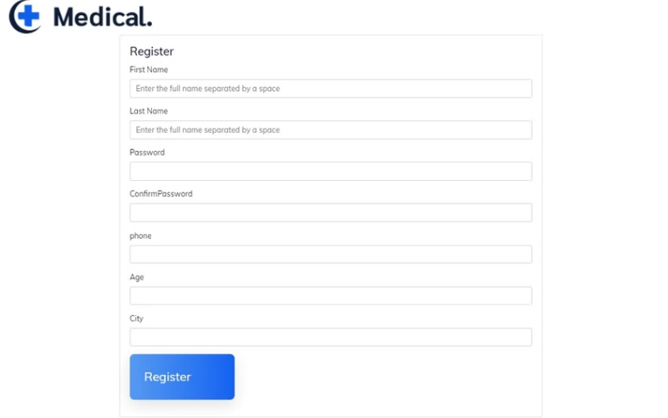
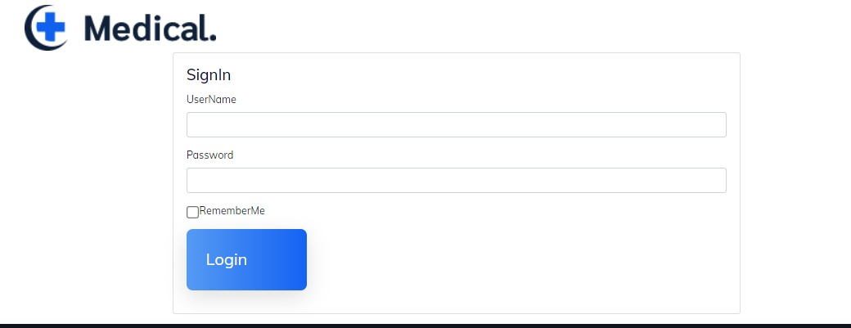
Registration and Login

Slide 15

Appointment

Slide 16
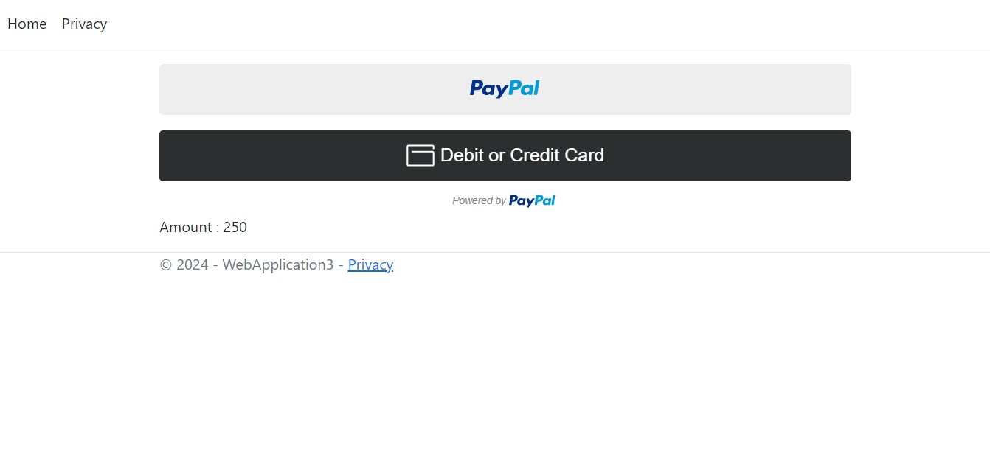
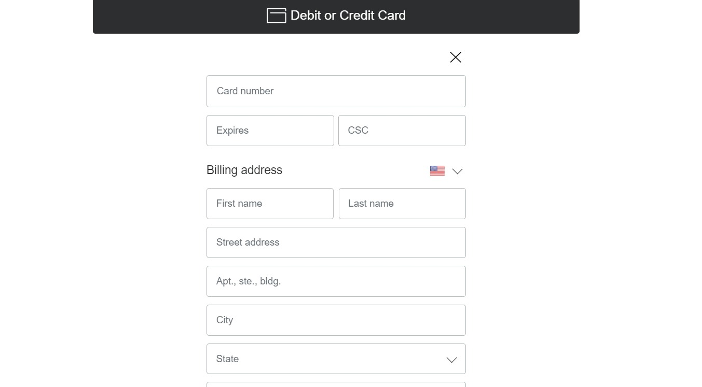
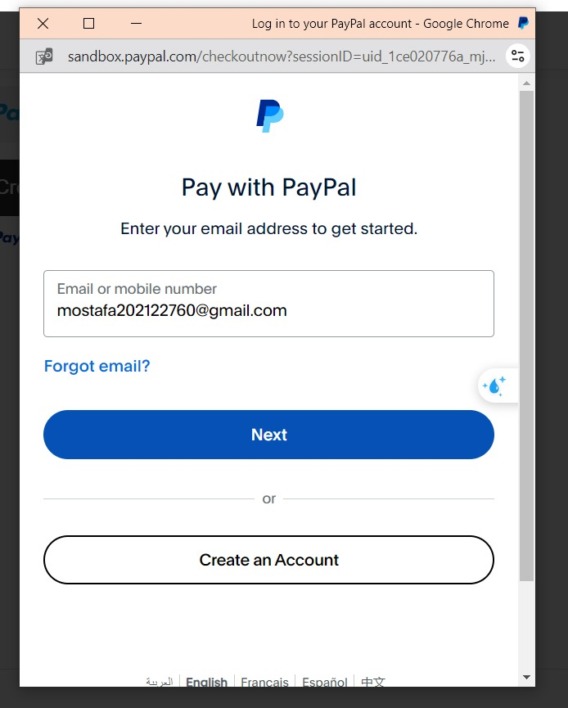

Payment

Slide 17
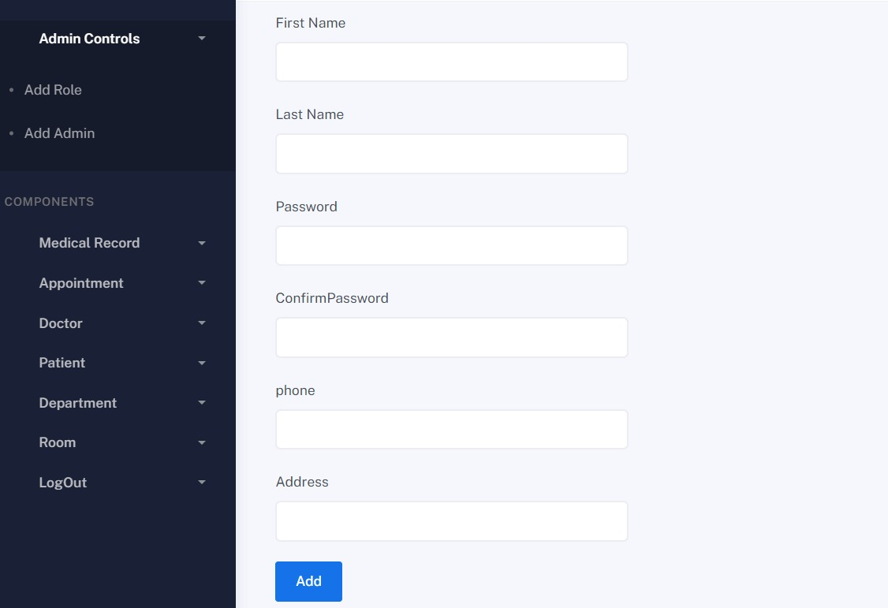
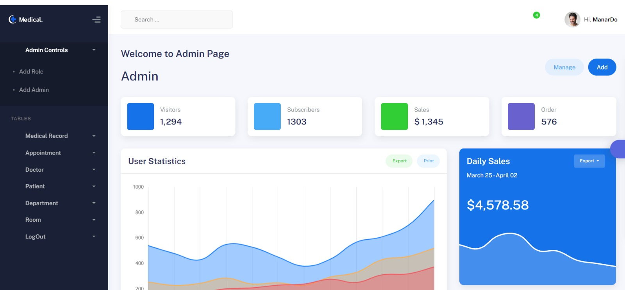
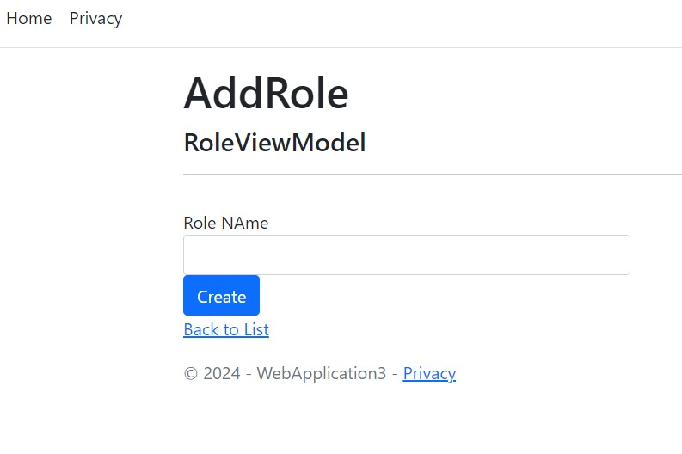
Admin

Slide 18
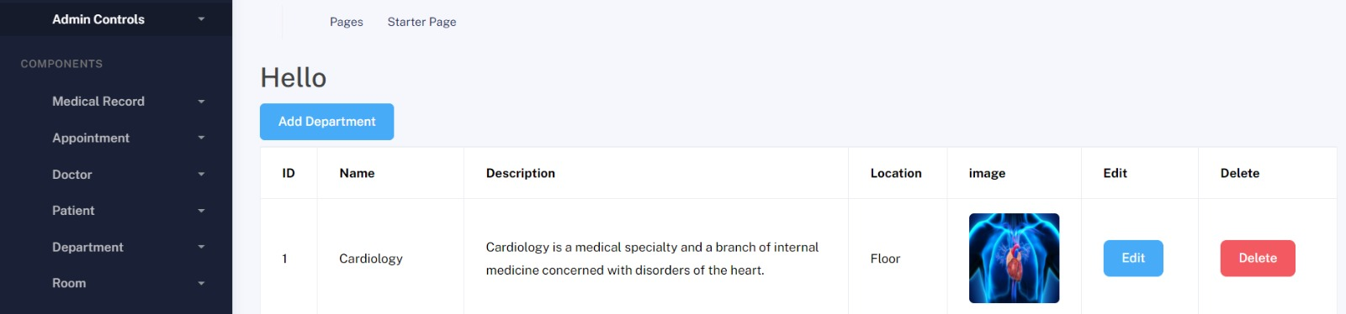
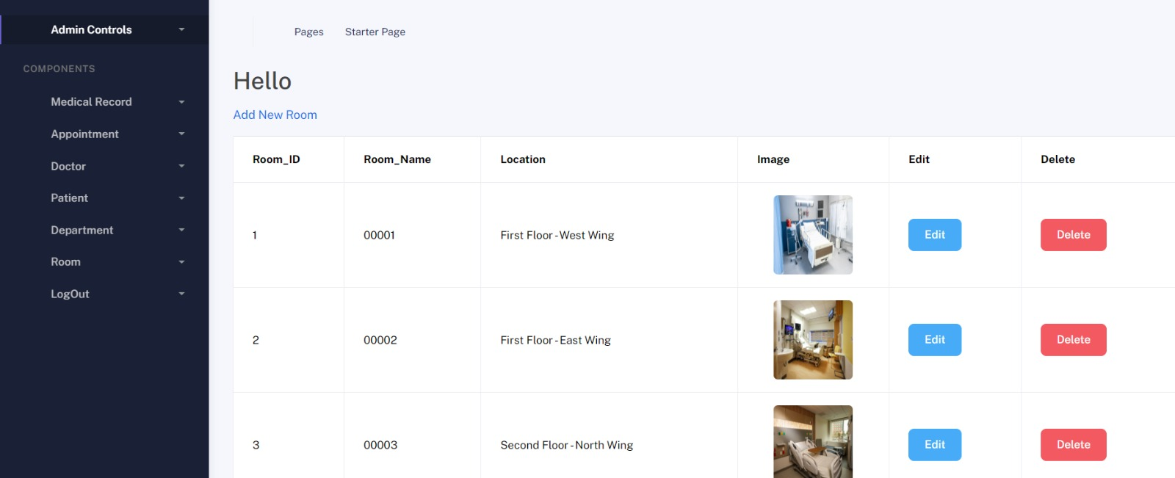
Admin

Slide 19
Thank you
لإاشىم
س

